Slide 1
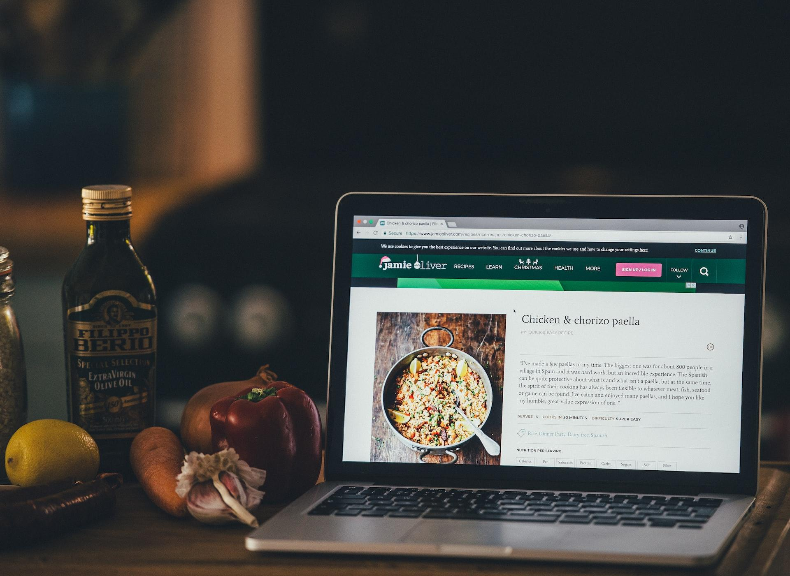
Food For Thought- Food Blog Application
User Experience Design and Testing Midterm Project
Group Members:
Ankita Senapati
Merwin Roy
Anusha Poojary
Surbhi Parihar
Krishna Pal Singh

Slide 2
TABLE OF CONTENTS
SLIDES | TOPIC
3-4 | PROJECT OVERVIEW
5-6 | PROBLEM STATEMENT AND SOLUTION
7-9 | STYLE GUIDE
10-12 | PRODUCT OBJECTIVES
13-15 | TARGET AUDIENCE
16-18 | USER SEGMENTATION
19-21 | USER NEEDS
22-23 | ONBOARDING
24-39 | USE CASES AND PERSONAS
40-41 | UX RESEARCH METHODS
42 | INTERACTIVE PROTOTYPES
43 | CREDITS

Slide 3

01
OVERVIEW

Slide 4
OVERVIEW
Proposed a UI/UX design and testing project for a food blogging web application.
With wide, ubiquitous presence of food delivery and blogging applications. We wanted to present an application with an unrivalled interface that will provide a seamless, transparent user experience which is conducive to deliver user needs efficiently, resulting in user retention to the application for posting food pics, recipes, food/restaurant reviews and ratings, suggestions, tips and much more.

Slide 5

02
PROBLEM STATEMENT

Slide 6
PROBLEM STATEMENT
Bloggers have a difficult time in finding a platform, especially for something as niche as food blogging. The application helps bloggers and other stakeholders connect.
Users on a time crunch have difficulty following a recipe for meal preparation, the platform can provide step by step guidance for a variety of cuisines.
The platform can become a common yet reliable interface for restaurant/cuisine reviews and recommendations.
There are few platforms that provides discourse pertaining to culinary field, which “Food For Thought” fulfills.
The application helps people to implement wide variety of options to filter their search, which is particularly useful for users who want avoid allergens, apart from financial and time constraints that comes with searching and ordering food,

Slide 7
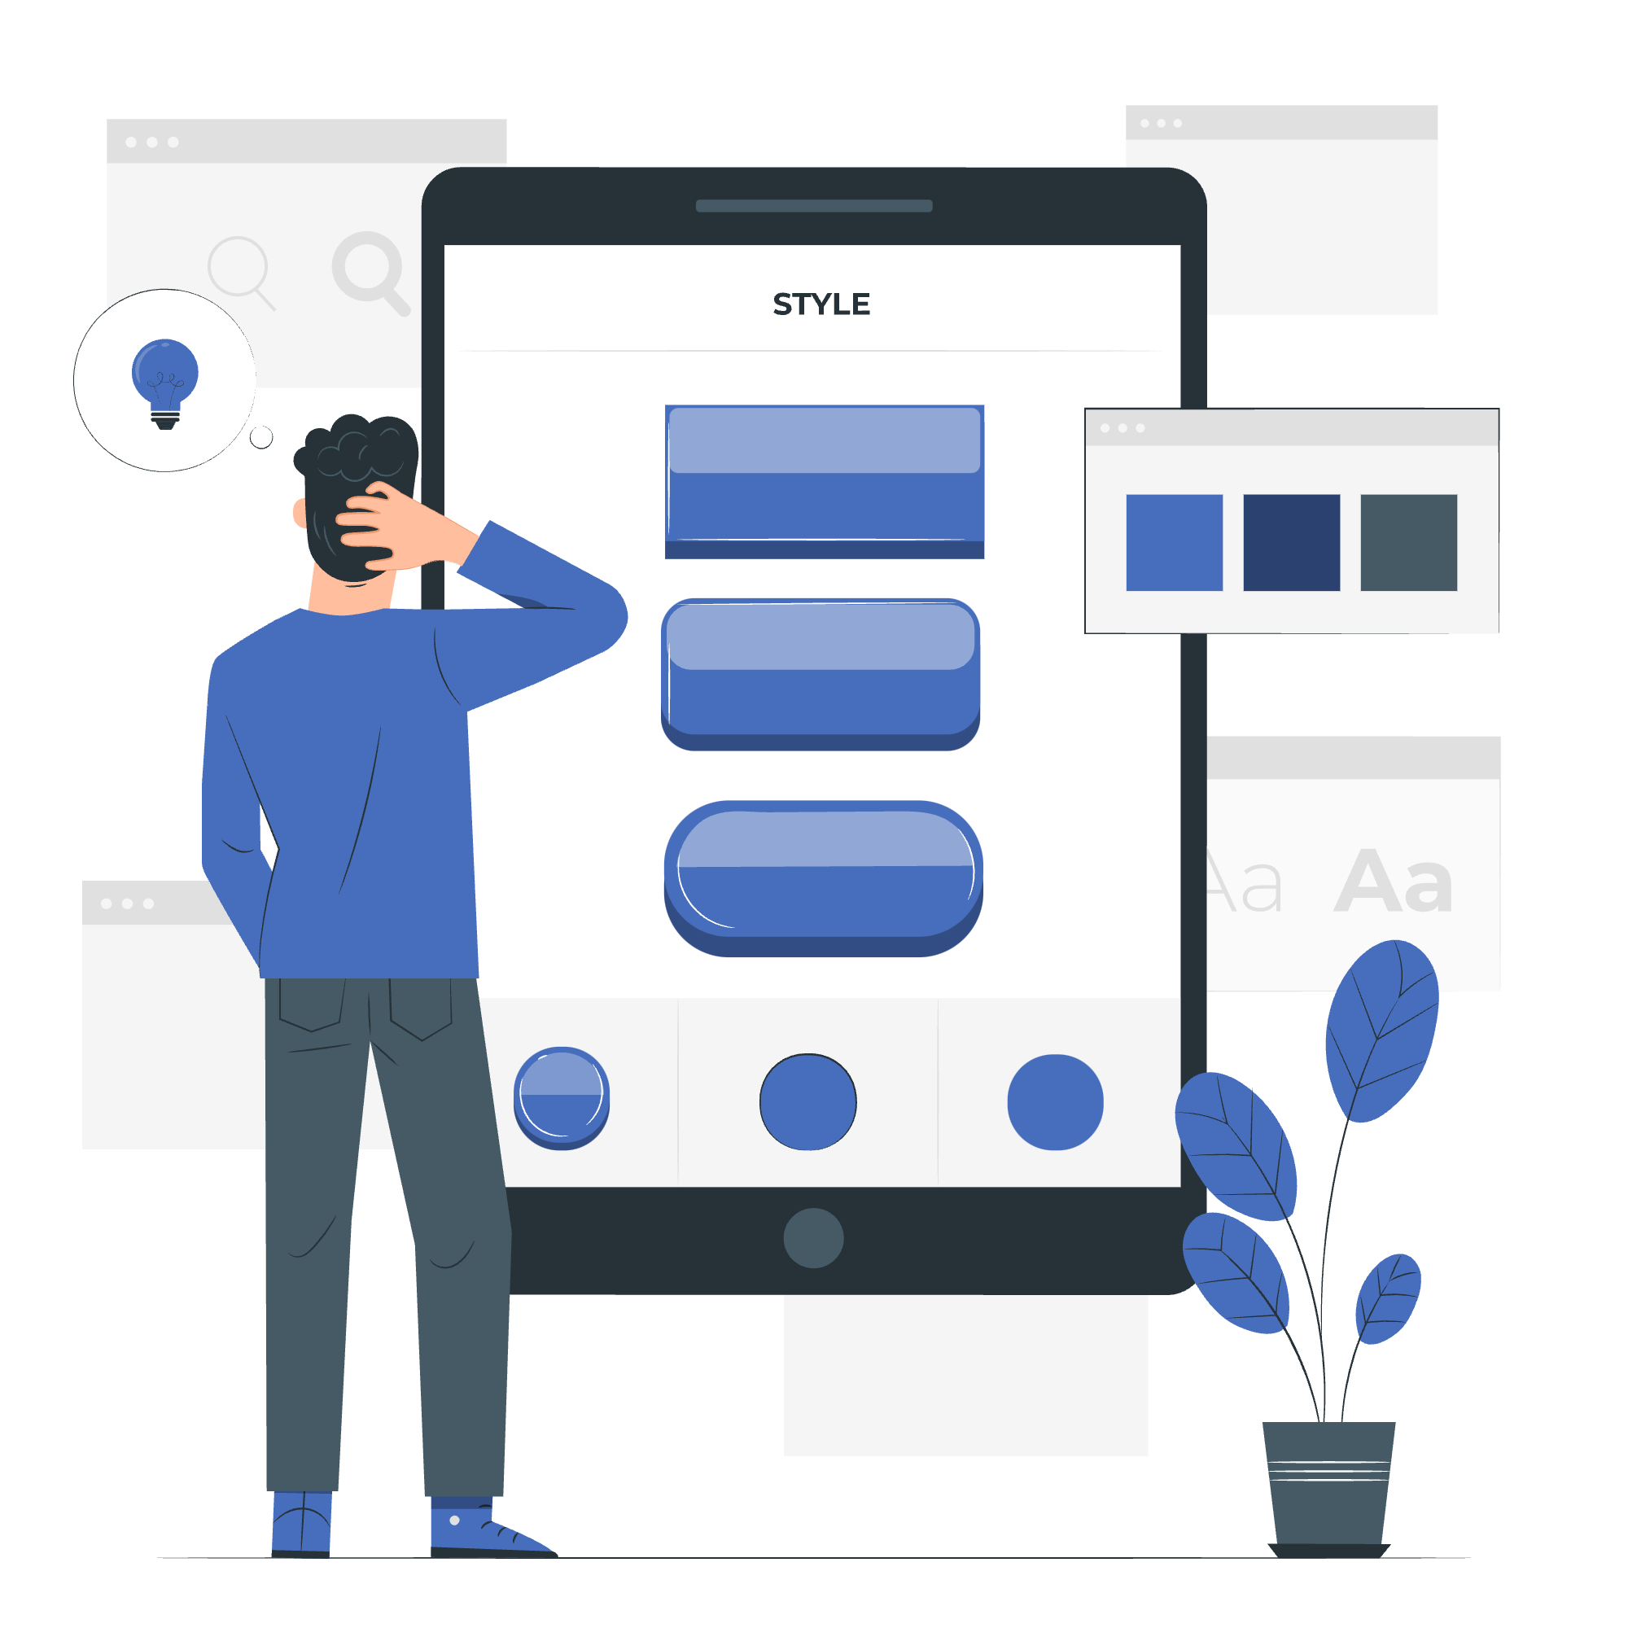
03
STYLE GUIDE

Slide 8

STYLE GUIDE
Logo Used
Color Guide-76a5af
Primary Color Used:
Background Color For Dialog Boxes:
Font Color:
#0c343d
#cf2a27
#45818e
#76a5af
#ffffff
#741b47

Slide 9
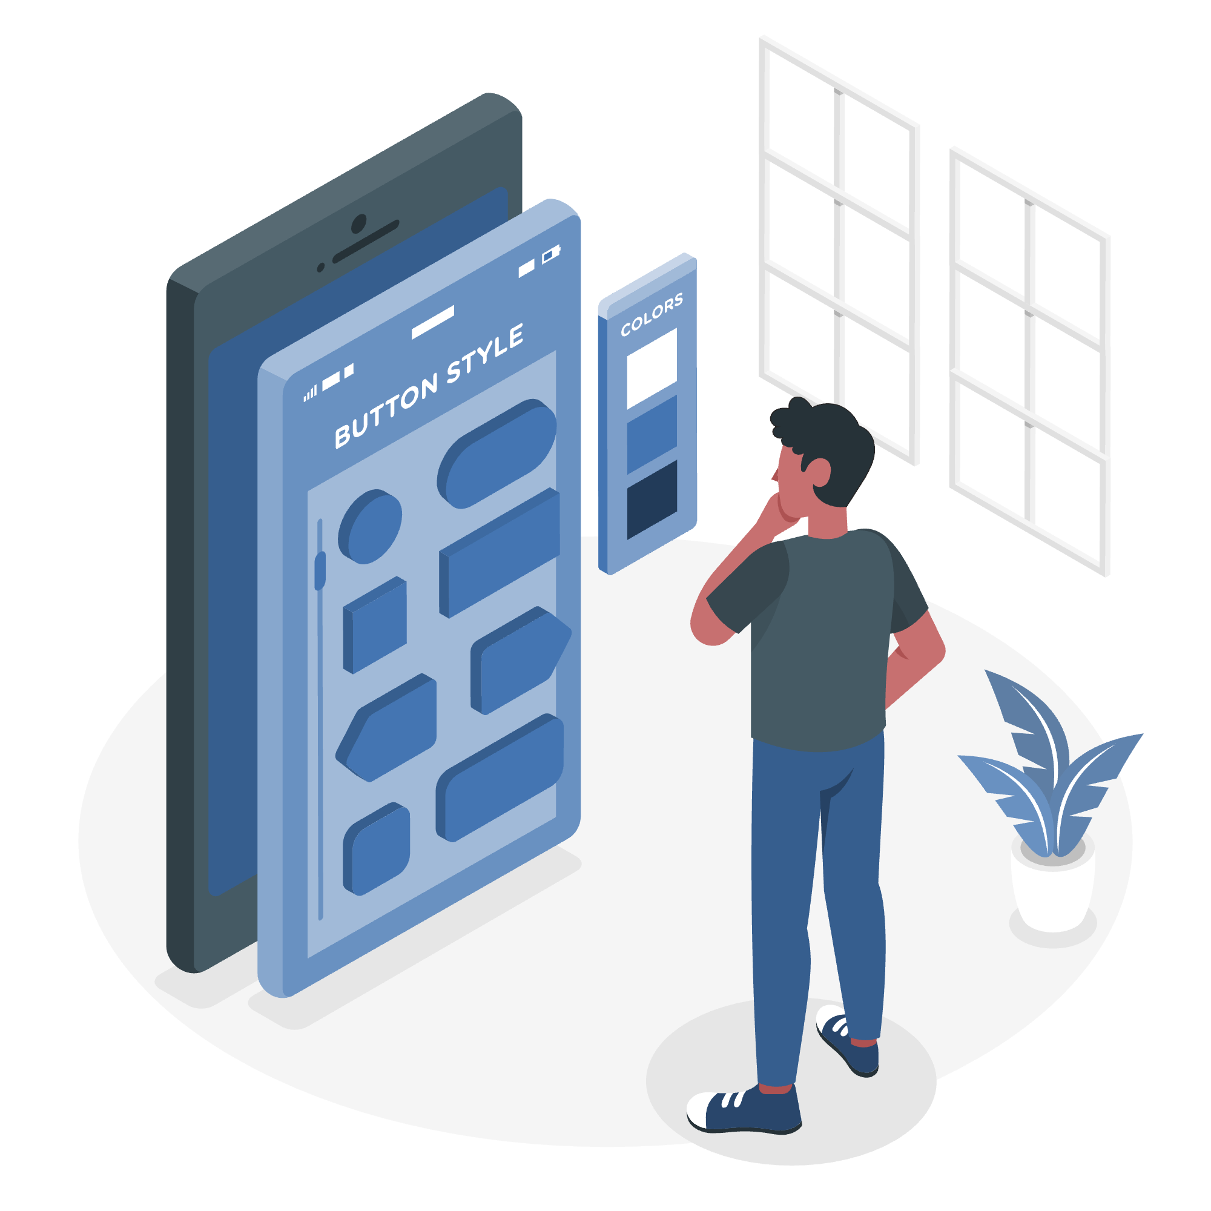
Iconography
Buttons and Nav placement
Essential UI components
Home, Write, Profile, Logout, Sign In, Notes, Arrows, Toolkit, Headphone, etc.
After user signs in, the navigation options to various pages have been provided at the bottom of the application.
Vertical scrollbar, Use of accurate icons, alerts for tasks

Slide 10

04
PRODUCT OBJECTIVES

Slide 11
PRODUCT OBJECTIVES
Personalized Experience: Use of surveys and filters to effectively fulfill user needs whether its posting recipes, restaurant and cuisine reviews etc.
Feedback: Create a platform where users can rate, comment and share food recipes, cuisines, customer experience and restaurants.
Simplicity: To provide a simple yet effective user experience for bloggers and users that is seamless and easy to navigate.
Intuitive: Provide an intuitive experience using HD pictures with quick description for a seamless experience

Slide 12
Integration: Provide robust integration with social media handles such as facebook, instagram, pinterest etc.
Unique Experience: Provide an unrivalled user experience through the use of consistent themes and design.
Explore: Help users to explore new cuisine,recipes, restaurants nearby etc.
Filter: Provide feature to filter posts based on ingredients, allergens, location, price to fit user requirement.

Slide 13
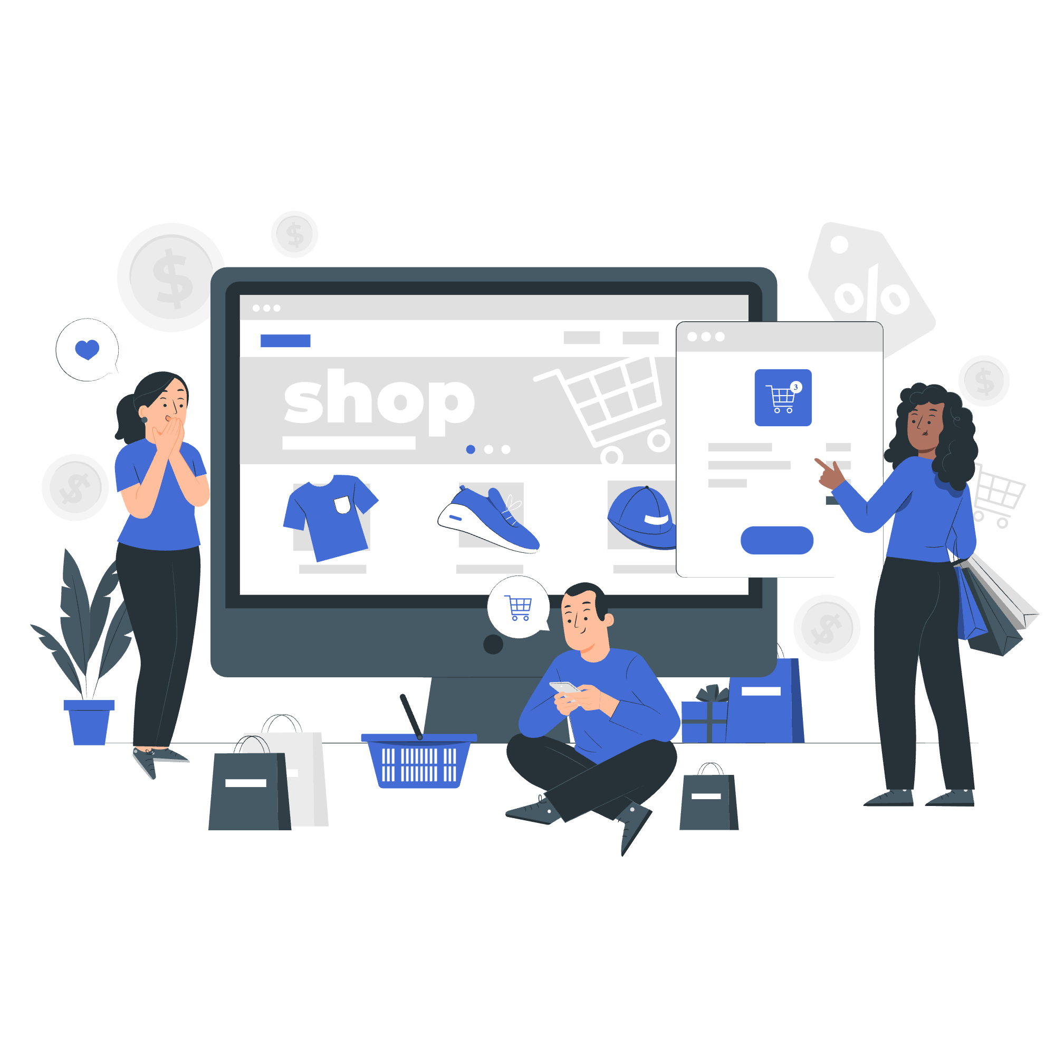
05
AUDIENCE

Slide 14
TARGET AUDIENCE
Food Photographers: Users can post high definition food photos and earn likes, shares and subscribers. It can help such users to promote their work and gain wide user base.
Blog writers: Users who are fond of writing blogs can post food related blogs on this platform. They can gain insights from other bloggers using the platform.
Restaurateurs: Users who own/manage business can check trends based on blog posts, analytical information such as likes, shares on posts, popular bloggers and their content for business decision making, promotion etc.

Slide 15
Customers: Users who want to try out new cuisine/ restaurants can read comments/reviews/ratings of cuisine or restaurants beforehand.
Cooking Enthusiasts: Users who seek interest in cooking new recipes can do so by following recipes posted on the platform.
Fitness Enthusiasts: Users who track their macros, and food intake can check ingredients, calories, possible allergens, and other such nutritional information as posted by blog posters.

Slide 16

06
USER SEGMENTATION

Slide 17
USER SEGMENTATION
1.Location Segmentation:
Segmenting users of the platform based on their geographic location. Users can be recommended cuisines, restaurants, blog posts that aligns with the place they are from.
2.Purchasing segmentation:
Users segmented based on their expenditure such as users who are high spenders can explore gourmet, expensive cuisines/restaurants.
Users who are low spenders can search for cuisines/restaurants which are less expensive. Such users can also be recommended restaurants with discounts to order from using food delivery applications

Slide 18
3.Relationship Segmentation:
Segmentation based on user usage of the platform. Frequent users, bloggers can be incentivised by point system which can be redeemed to earn discounts on restaurants etc.
Likewise, customers who actively interact with blog posts can be provided incentives.
4.Demographic segmentation:
Segmentation based on user data such as age, income, interests, user need that can be achieved through data collected via data analytical tools and surveys.
5. Exposure segmentation:
Segmentation based on user exposure to digital technology or little to no culinary, blogging experience can be assisted by providing tooltips from time to time and by implementing simple, consistent and interactive UI.

Slide 19

07
USER NEEDS

Slide 20
USER NEEDS
Users should be able to post quality pictures of food and restaurants, and write quick description, recipes, fill nutritional information etc seamlessly.
Users should find it easy to navigate through the platform to search restaurants, cuisines, recipes and filter requirements accordingly.
Users must be made aware of usage of cookies and data collection to collect information for a more personalized and optimized recommendation, and user experience to ensure transparency.
Users must be notified of interactions on their posts or uploads from bloggers they subscribed to.

Slide 21
Users should be comfortable with the interactions in platform’s UI by taking ergonomics(placement of frequently used features/action items), consistent and meaningful use of themes and colors into consideration.
Users must be recommended posts that falls closest to their natural line of interest. (eg: photography, culinary categories).
User feedback must be easy to find and use and should be treated as an imperative function of the platform.
Users must find it intuitive to use the platform.

Slide 22

08
ONBOARDING

Slide 23
ONBOARDING
Onboarding is an important aspect to make new users familiar to the product. If the product appears too confusing or have minimal guide, it might frustrate the users resulting in user loss.
In our application, we have provided a quick navigation tour to familiarize users with app features after they sign up.
Below are four onboarding pages that we have included in the product prototype.
Explore Restaurants
Create,View & Share Blogs
Read Popular Recipes Reviews
Like, Follow and Share Blogs.

Slide 24

09
USE CASES AND PERSONAS

Slide 25
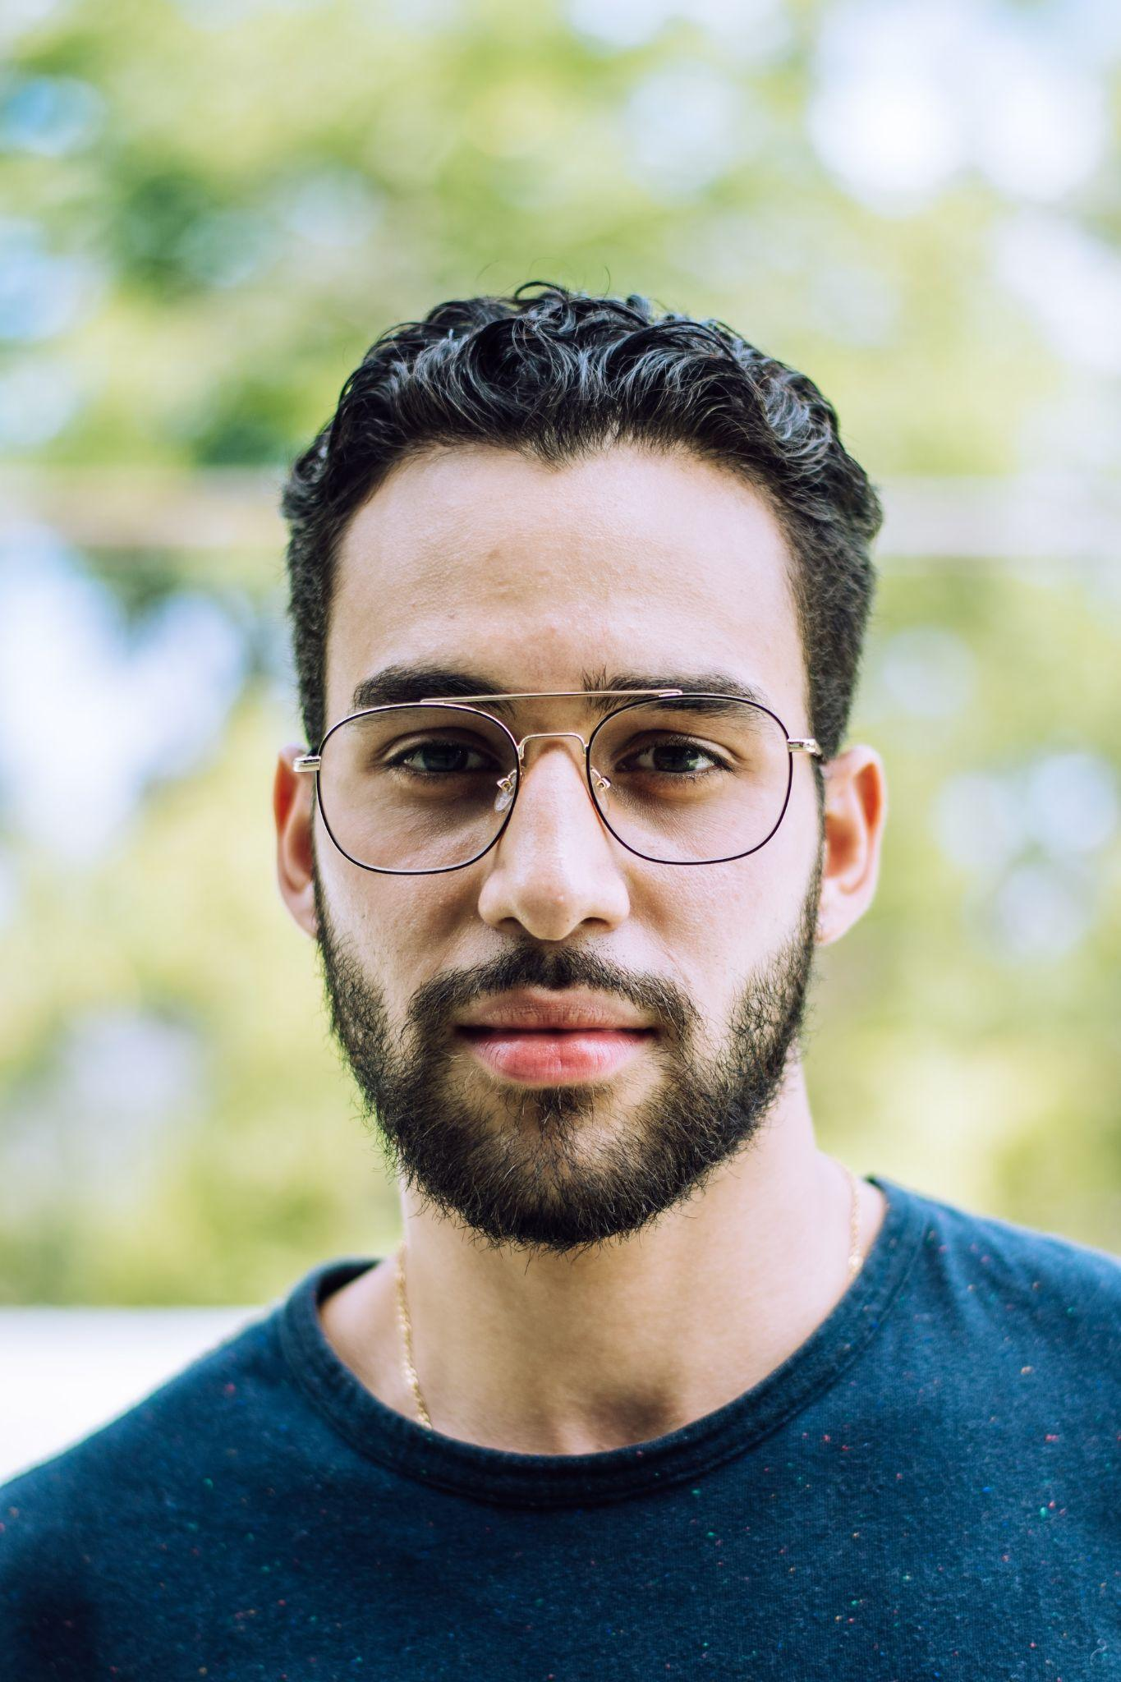
USER PERSONA 1: JAMES ROE
ABOUT USER
“I like to travel a lot, and it gets difficult to find good places to eat”
James is a youngster for whom making a style statement means a lot and is looking for the right online marketplace to buy his apparel from.
PROFILE
GOALS AND FRUSTRATIONS
Name: James Roe
Age: 19
Occupation: Travel Vlogger
Household Income: 20000$ / year
Technical profile: proficient with technology, Uses a Macbook, 100 mbps internet connection.
Internet use: 30% mobile internet, 60% public internet
Favorite sites: Pinterest, Instagram
GOALS:
James wants to try the best local cuisine when he visits a new town.
He can invest his time and effort reading through the blogs and then explore that restaurant.
FRUSTRATIONS:
James is frustrated because google reviews are misleading sometimes and are too commercial to be trusted.

Slide 26
USE CASES
USE CASE (Middleweight)
USE CASE (Heavyweight)
Actor | James
Use Case | Trying local food at new restaurants
Description | James wants to try the best local cuisine when he visits a new town
Basic Flow | Search for all the small restaurants nearby that serve local cuisine
Alternate Flow | Search for a specific blog posted for that specific restaurant using keywords containing restaurant name, city name.
Actor | James
Use Case | Trying local food at new restaurants
Description | James wants to try the best local cuisine when he visits a new town
Pre-Condition 1 | Users should have a laptop or mobile to access the website. They can use Guest user to browse through blogs.
Pre-Condition 2 | Users should have a shortlisted list of restaurants in the town that he wants to explore.
Basic Flow | Search for all the small restaurants nearby that serve local cuisine. Filter by rating to find most rated places.
Alternate Flow 1 | Search for a specific blog posted for that specific restaurant using keywords containing restaurant name from the shortlisted names. Try finding blogs to read detailed review.

Slide 27
BASIC AND ALTERNATE FLOWS
Use Case | Finding a good restaurant by reading blogs
BASIC FLOW 1
ALTERNATE FLOW 1
ALTERNATE FLOW 2
1 | Login to the website
2 | Go to Home page of the website
3 | Go to search bar and enter restaurant name
4 | Browse the blogs and select a particular blog if available for that restaurant.
5 | If no results are found, try searching with a different keyword.
1 | Login to the website
2 | Go to search bar and type in a city name or a restaurant name.
3 | Look for the restaurants for which blogs have been posted.
4 | Browse the blogs and select a particular blog to read as a guest user.
1 | Login to the website
2 | Apply filter using city name
3 | Sort the blog results based on rating.
4 | Select the blog from results and read the same.

Slide 28
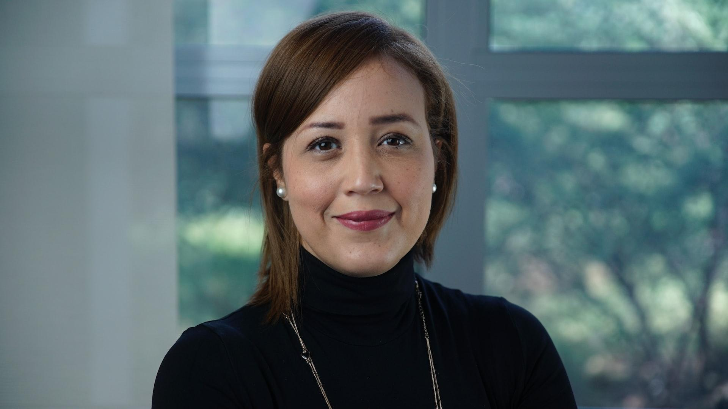
USER PERSONA 2: JANET MONAHAN
ABOUT USER
“I like to write in my free time, I write poems, columns and blogs.”
Janet is a lawyer who has the hobby of writing poems, letters, editorial columns, entertainment and food blogs.
PROFILE
GOALS AND FRUSTRATIONS
Name: Janet Monahan
Age: 35
Occupation: Lawyer
Household Income: 125000$ / year
Technical profile: proficient with technology, Uses a Macbook, macOS Monterey, 100 mbps internet connection.
Internet use: 40% at home, 60% at work
Favorite sites: Wikipedia, Tumblr, Wordpress
GOALS:
Janet wants to write food blogs sharing her recipes and secrets to her healthy recipe ideas.
FRUSTRATIONS:
Janet is frustrated when she cannot find the right audience for her blogs.

Slide 29
USE CASE AND BASIC FLOW
USE CASE (HEAVYWEIGHT)
Actor | Janet
Use Case | Write food blogs to share recipes and tips
Description | Janet wants to write blogs to share her family recipes and to provide tips to users for easy recipes.
Pre-Condition | Janet must have account in the application to write a food blog.
Basic Flow | Login to the application, go to dashboard. At the bottom, there are 4 menu options, click on the 2nd option from left to navigate to the Write a Blog page. Enter basic form details. Click on continue. In the new page, write the post and click on Post for review button.
Alternate Flow 1 | Login to the application, go to dashboard. At the bottom, there are 4 menu options, click on the 2nd option from left to navigate to the Write a Blog page. Enter basic form details. Click on continue. In the new page, change the blog category depending on Recipes or Food tips. After that click on continue to go to next page. In the new page, share your recipe, add pictures and click on Post for review button.

Slide 30
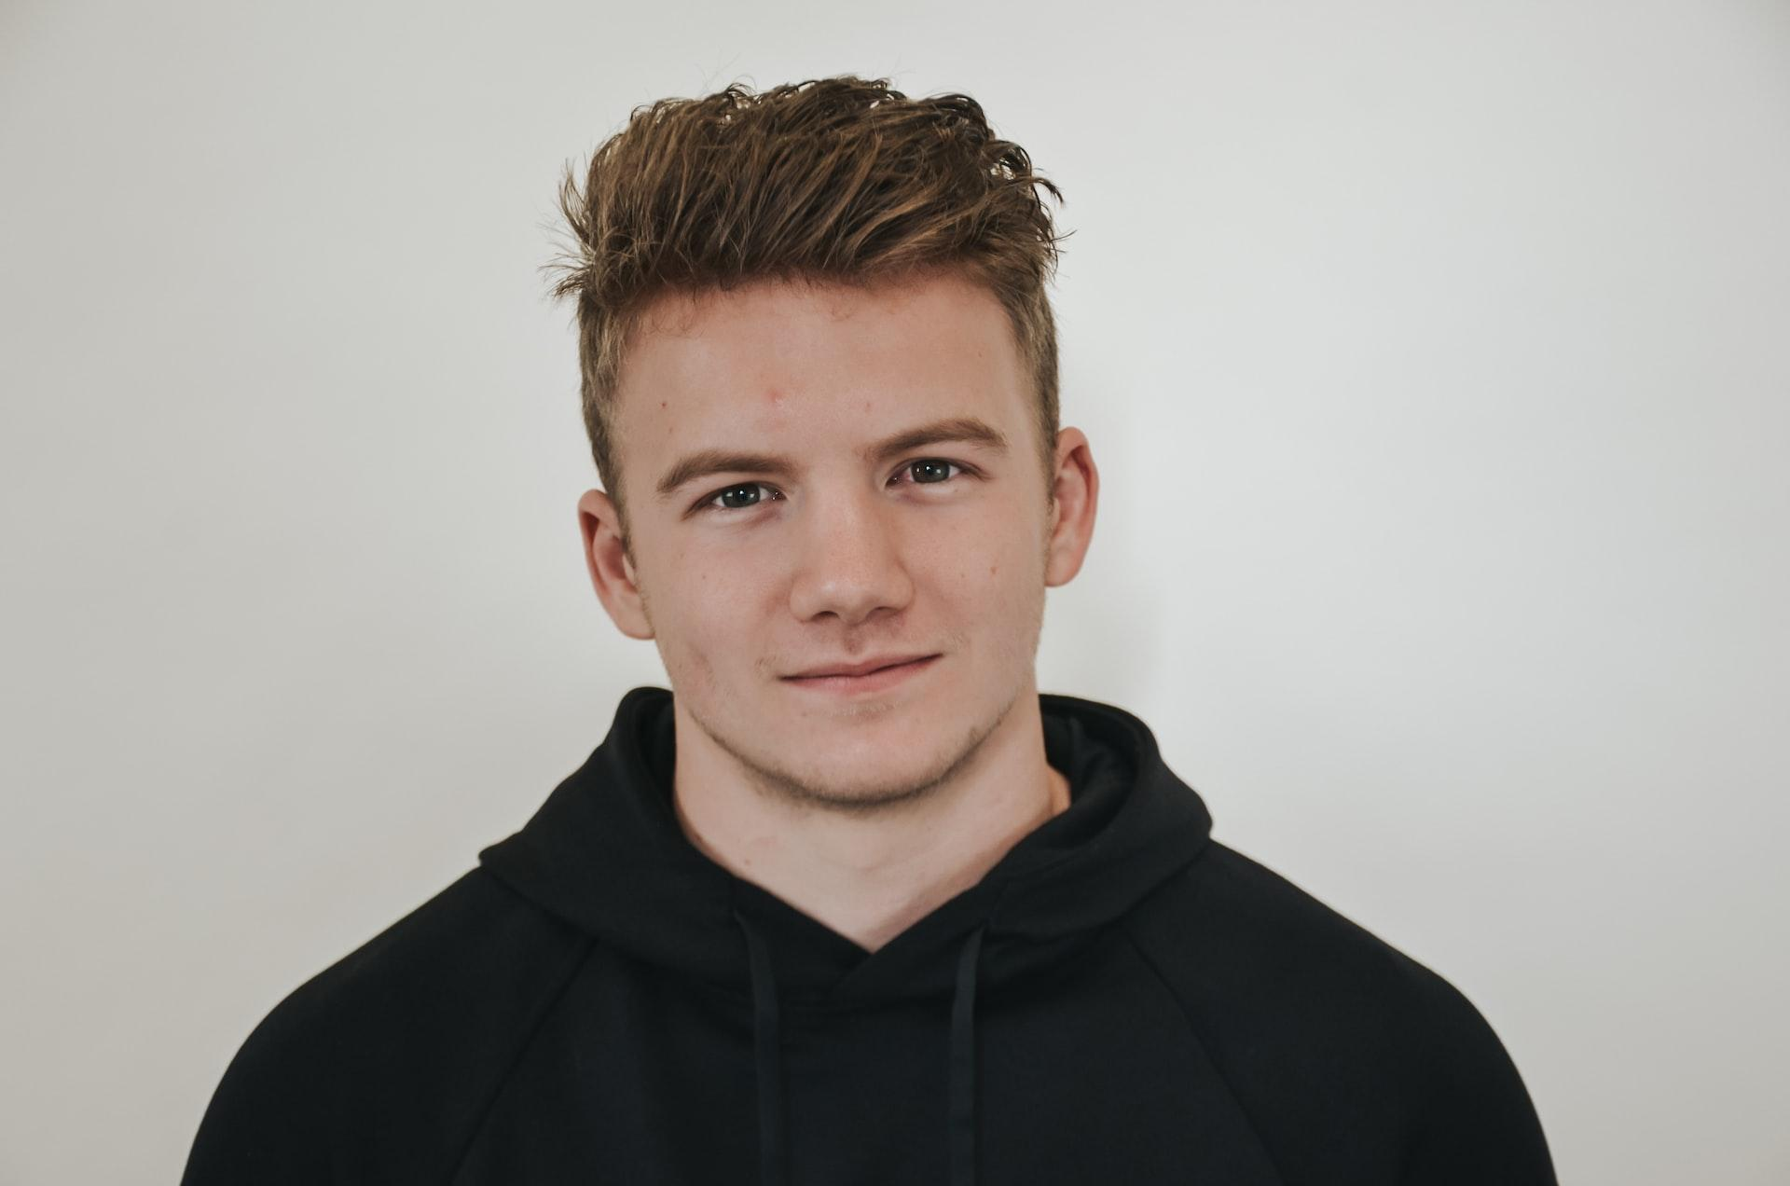
USER PERSONA 3: PETER ANDERSON
ABOUT USER
“I like to work out a lot and go to the gym regularly. I prefer maintaining a healthy diet”
Peter is a part-time student and a gym instructor. He enjoys healthy food and wants to make sure all his friends follow a similar healthy diet.
PROFILE
GOALS AND FRUSTRATIONS
Name: Peter Anderson
Age: 24
Occupation: Part-time Student, Gym instructor
Household Income: 50000$ / year
Technical profile: Proficient with technology, uses a windows desktop
Internet use: 80% at home, 20% mobile internet
Favorite sites: Instagram, EatingWell
GOALS:
Peter wants to promote healthy food eating habits and therefore wants to write blogs and promote restaurants serving healthy food.
FRUSTRATIONS:
Peter gets upset when he sees good restaurants serving healthy food do not get promoted very well and lose business.

Slide 31
USE CASES
USE CASE (MIDDLEWEIGHT)
USE CASE (HEAVYWEIGHT)
Actor | Peter
Use Case | Write blogs on healthy food habits
Description | Peter wants to promote healthy food via blogs
Pre-Condition | Users should have a laptop/desktop or mobile to access the website
Basic Flow | Peter logs into his account, writes a post about a restaurant serving healthy food, shares pictures and provides disclaimer about allergens as well.
Alternate Flow 1 | Peter logs into his account and writes a blog providing healthy food recipes, targeting audiences who go to gym regularly with proper nutrient charts for a recipe.
Actor | Peter
Use Case | Peter wants to comment on blogs about healthy food items.
Description | Peter wants to promote healthy food via blogs
Pre-Condition | Users should have a laptop/desktop or mobile to access the website. User must have an account in the application.
Basic Flow | Peter logs into his account, browses through post in dashboard. Clicks on Add Comment to write a comment on a blog.
Alternate Flow 1 | Peter logs into his account, browses through post in dashboard. He clicks on Read More option. It takes the user to Read Blog page. Scroll to bottom. Click on Add Comment button.

Slide 32

USER PERSONA 4: MAXINE MAYFIELD
ABOUT USER
“I am a Software Engineer who loves to travel around the city and try new restaurants and cafes. In my free time I write and read blogs about travel and food.
Maxine is a software engineer who wish to try new Cuisines around the city and rate them based on their taste.
PROFILE
GOALS AND FRUSTRATIONS
Name: Maxine Mayfield
Age: 28
Occupation: Software Engineer.
Household Income: 90,000$ / year
Technical profile: Comfortable with technology, Uses a MacBook and an iPhone, 100 Mbps internet connection.
Internet use: 60% at the Office and 20% at Home.
Favorite sites: Grubhub, Zomato
GOALS:
Maxime wants to search for highly rated restaurants and cafes around the city.She does not have enough information about the local restaurants and cafes in City.
FRUSTRATIONS:
Maxine is frustrated due to a busy schedule and office work.

Slide 33
USE CASE AND BASIC FLOW
USE CASE (HEAVYWEIGHT)
Actor | Maxime
Use Case | Trying new cuisines
Description | Maxine wants to try Highly rated restaurants and cafes.
Pre-Condition | Users should have a laptop or mobile to access the website
Basic Flow | Search for all the High rated blogs in the city.
Alternate Flow 1 | Search for a specific restaurant and get information about it based on its blog’s rating. ( eg Indian, Mexican).
Alternate Flow 2 | As per her search history, gets similar recommendations, like other nearby restaurants.

Slide 34
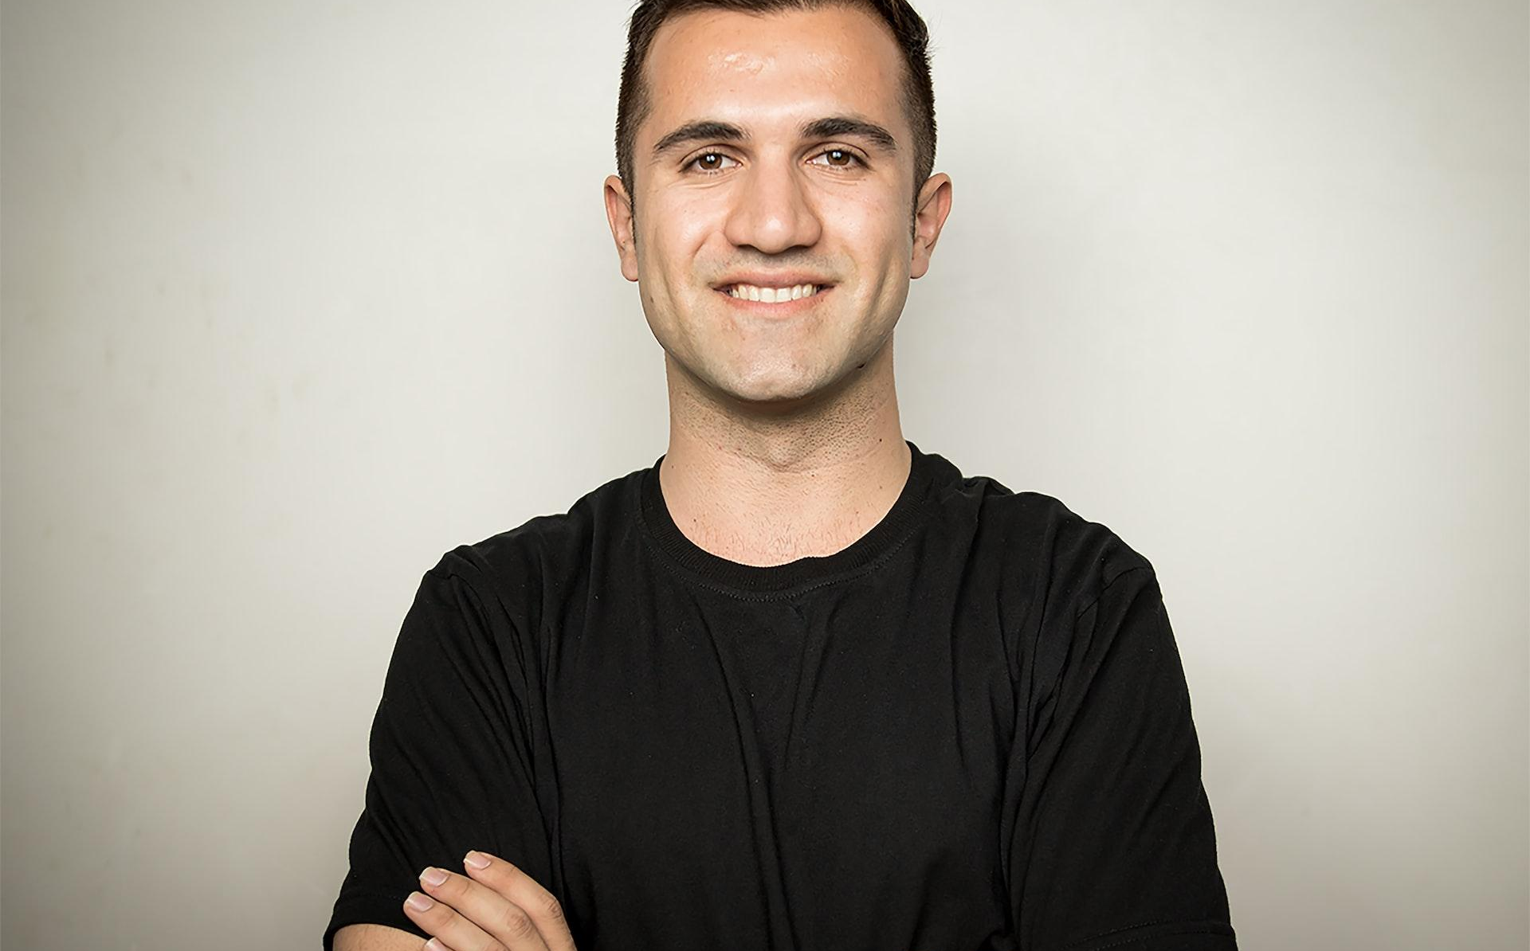
USER PERSONA 5: JOHN FERNANDEZ
ABOUT USER
“I want to expand my business based on user needs”
John is a restaurateur who wants to expand his small business and wants insight on the cuisine and user requirements that influence their decision to order food item from a particular restaurant.
PROFILE
GOALS AND FRUSTRATIONS
Name: John Fernandez
Age: 33
Occupation: Restaurateur
Household Income: 95k$/year
Technical Profile: Very comfortable with technology, Windows Laptop running windows 10, 100mbps internet connection
Internet use: 80% at office Favorite site: eBay
GOALS:
Gain insights of users who view and order food items from food blog posts and eventually place order from restaurants
FRUSTRATIONS:
Food blogging websites and applications put very little emphasis on business owners who want to understand the business trends and expand their business accordingly.

Slide 35
USE CASE AND BASIC FLOW
USE CASE (HEAVYWEIGHT)
Actor | John
Use Case | View the blogs posted different users and gain insights from same
Description | John wants to view blogs posted by users and see impact on business.
Pre-Condition | John must have created account in the application to add comments and view detailed review.
Basic Flow | Login to the application, go to dashboard. Select location or business/restaurant name. View blogs available for that restaurant. See the ratings and comments by various users. If blogs are good, it will attract more users to those business thus promoting the same.
Alternate Flow 1 | Login to the application, go to dashboard. Select location or business/restaurant name. View blogs available for that restaurant. See the ratings and comments by various users. Find out which restaurant has most rating and most comments. If the user is familiar with the restaurant, can add comments approving or disapproving with the blog content.

Slide 36
BASIC AND ALTERNATE FLOWS
Actor | John
Use Case | John wants to research on impact of food bloggers on consumers.
Description | John wants to research on impact of food bloggers on consumers.
Pre-Condition | John must have an account in the application to gain insights.
Basic Flow | Search for authors with many blogs. Sort based on the author name. Find the popularity of the author from ratings on post, positive comments.
Alternate Flow 1 | Go to user dashboard, filter posts based on rating. Browse through comments to find what users like about the author’s post. Through comments find how authentic is the blog content. Find out percentage of bloggers who post images along with the text content.

Slide 37
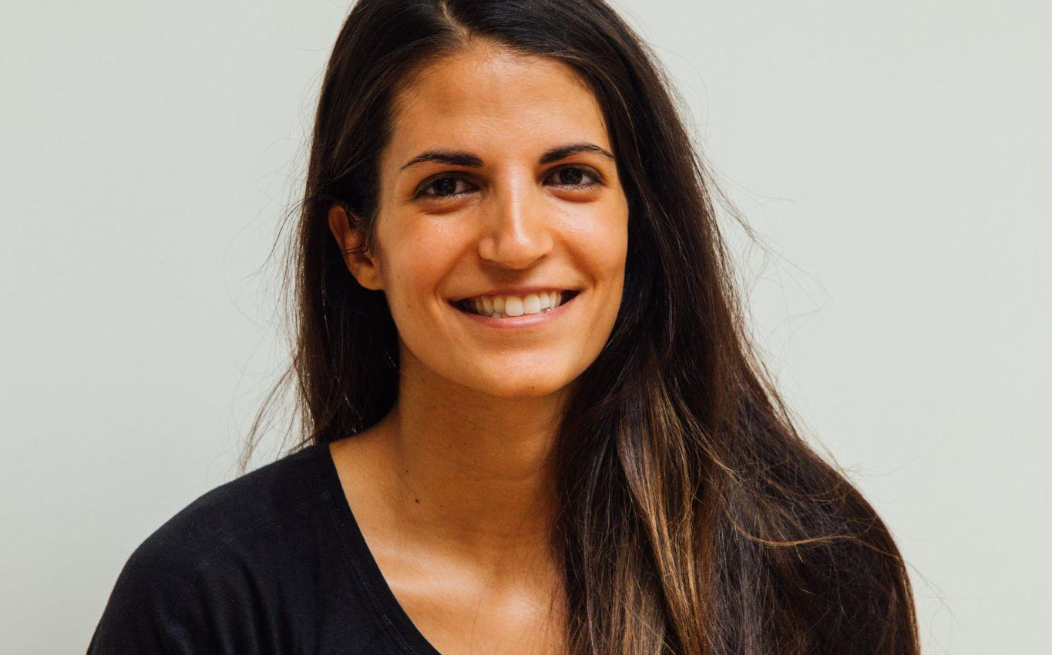
USER PERSONA 6: NANCY CUTTING
ABOUT USER
“I am a nurse, who loves serving people. Owing to the nature of my line of work, I can hardly afford time to take breaks and I prefer maximizing my time tending to patients who need medical assistance.”
Nancy is a nurse and mother of 2 children. She doesn't have enough time to cook food on a regular basis and cannot search through different restaurants to order food from during shifts.
PROFILE
GOALS AND FRUSTRATIONS
Name: Nancy Cutting
Age: 45
Occupation: Nurse
Household Income: 10000$ / year
Technical profile: Comfortable with technology, Uses a Macbook, 100 Mbps internet connection.
Internet use: 60% at Hospital and 20% at Home.
Favorite sites: amazon, Macy's
GOALS:
Nancy wants to order food with minimal wait time for delivery.She opts to order food from restaurants closest to her and which has best reviews available by good bloggers.
FRUSTRATIONS:
Busy work hours and minimal breaks leave very little time for her to browse restaurants/food items.

Slide 38
USE CASE AND BASIC FLOW
Actor | Nancy
Use Case | Order food with minimal estimate time of delivery.
Description | Nancy wants to spend minimal time on lunch breaks to tend to patients as quickly as possible
Pre-Condition | Users should have a laptop or mobile to access the website
Basic Flow | Search for restaurants closest to her workplace or order dish with minimal prep time.
Alternate Flow 1 | Filter restaurants based on proximity/location from her workplace
Alternate Flow 2 | Customize user profile to get blog posts based on restaurant location/minimal food prep time.

Slide 39
BASIC AND ALTERNATE FLOWS
Heavyweight Use Case
Actor | Nancy
Use Case | View the blogs posted by self
Description | Nancy wants to view the blogs that she has posted in the application, read comments, check status after posting a new blog. My Blogs page can be used to view the blogs posted by a user.
Pre-Condition | Nancy must have created account in the application and must have at least 1 blog posted.
Basic Flow | Login to the application, go to dashboard. At the bottom, there are 4 menu options, click on the 3rd from left to view the list of blogs posted by ownself.
Alternate Flow 1 | Login to the application, go to dashboard. At the bottom, there are 4 menu options, click on rightmost Profile icon. This will give list of available options. Click on My Blogs option to view the list of blogs posted by ownself.
Alternate Flow 2 | Login to the application, go to dashboard. At the bottom, there are 4 menu options, click on 2nd option from left- write a blog option. This will take you to Write a Blog page. Enter necessary details and create the blog. At the end an alert will popup with option to navigate to My Blogs page.

Slide 40

10
UX RESEARCH
METHODS

Slide 41
UX RESEARCH METHODS
FONT STYLE
DIARY STUDY
USABILITY-BUG REVIEW
Logged End user habits and interactions whilst using the application to identify user behavioral patterns, issues with features and functionalities of the application.
Defined 4W’s of evaluation (Who,What,Why,Where) to walk through each scenario and keep track of features and functions of the product.
INTERACTIVE PROTOTYPING
Created product prototype using Balsamic tool to help visualize,understand and test product design, interactions and flows.

Slide 42
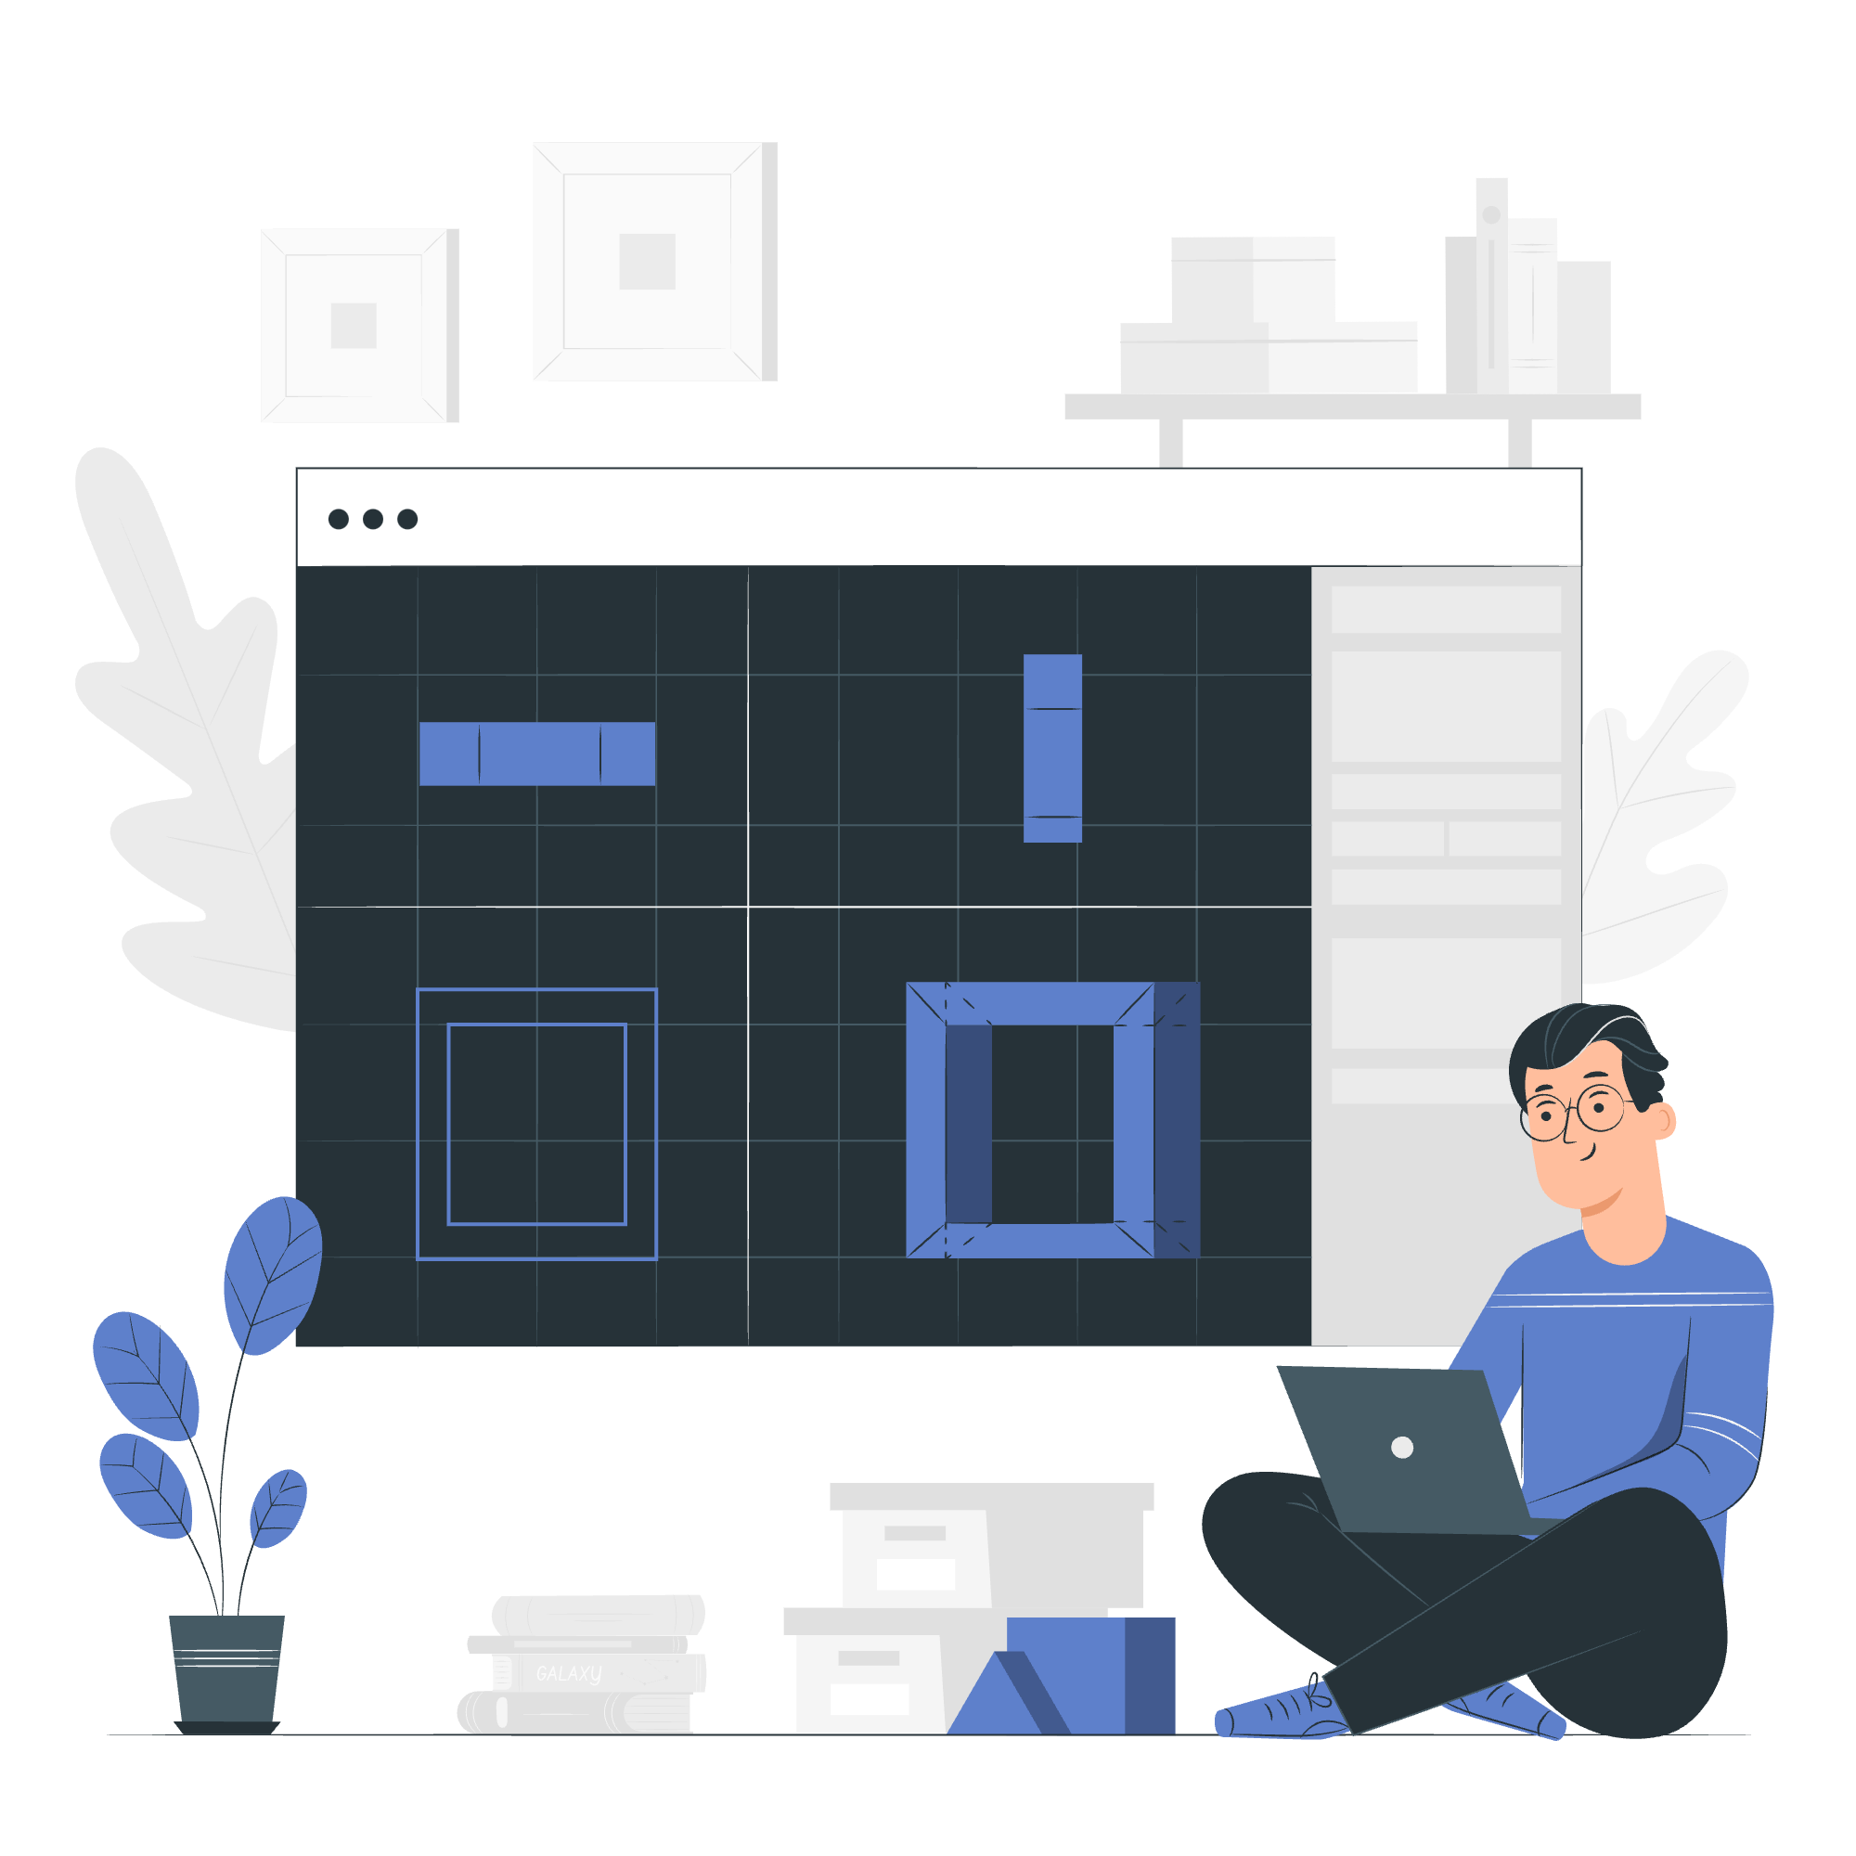
11
INTERACTIVE
PROTOTYPES

Slide 43
THANK YOU
TEAM MEMBERS:
ANKITA SENAPATI
MERWIN ROY
ANUSHA POOJARY
SURBHI PARIHAR
KRISHNA PAL SINGH

